Slide 1

Building Violations Final Report
Team C:
Youxuan Ma, Guanxi Li,
Heyang Yu, Yuzhe Jiang, Jian Xie

Slide 2

Boston Building Violations Analysis
Objective:
The goal of our analysis is to uncover patterns and trends in building violations across Boston, identifying hotspots and recurring issues that may require attention from urban planners and policymakers.
Significance:
Building violations can impact community safety, property values, and urban development. By analyzing these violations, we aim to provide actionable insights that can help improve regulatory compliance and enhance living conditions in Boston.

Slide 3
Analytical Approach and Methodologies
Analytical Techniques Used:
Descriptive Analytics: Initial exploration of data through summary statistics to understand the distribution and central tendencies of violation incidents.
Geospatial Analysis: Utilizing geographic data to create heatmaps and location-based insights, which help visualize the concentration of violations across different neighborhoods.
Trend Analysis: Examining data over time to identify patterns or changes in the frequency of violations, which could indicate the effectiveness of policies or shifts in compliance behavior.
Clustering Analysis: Applying machine learning method to group categorical data.
Visualization Tools Employed:
Heatmaps: Used to identify high-density areas of violations and understand geographical distributions.
Bar Graphs and Pie Charts: Employed to present categorical data, such as the most common types of violations and the distribution across various streets and neighborhoods.
Python Libraries: Pandas for data manipulation, Folium for creating interactive maps, Matplotlib, and Seaborn for generating static visualizations, and etc.

Slide 4
Key Questions Addressed
Q1: Are there certain landlords / management companies that have repeated violations?
Q2: Are there common features of certain buildings?
Q3: What neighborhoods / communities are affected most?
Q4: What kinds of building complaints are people making around the city?

Slide 5
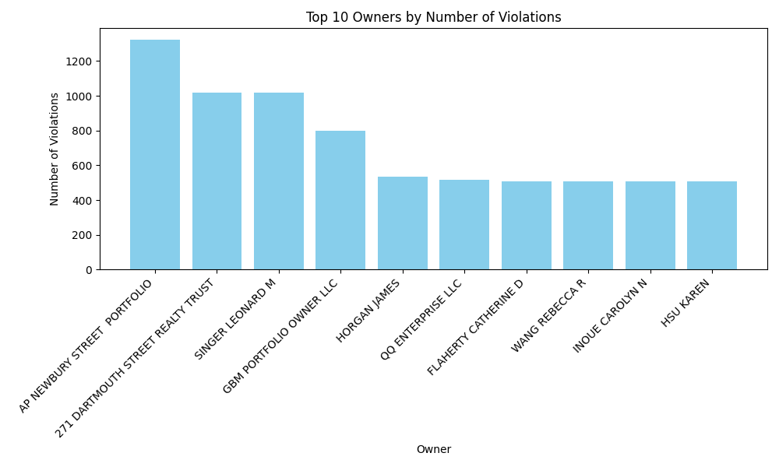
Insight 1: Repetitive Violations
Findings: Our analysis identified several landlords and management entities with a higher frequency of violations. Prominent among them are 'Ap Newbury Street Portfolio', '271 Dartmouth Street Realty Trust', and 'Singer Leonard M', each with substantial records of repeated violations.
Implications: This pattern suggests a potential focus area for regulatory bodies to enhance inspections and compliance checks. It also serves as crucial information for potential tenants and real estate professionals regarding which properties might pose a higher risk.

Slide 6
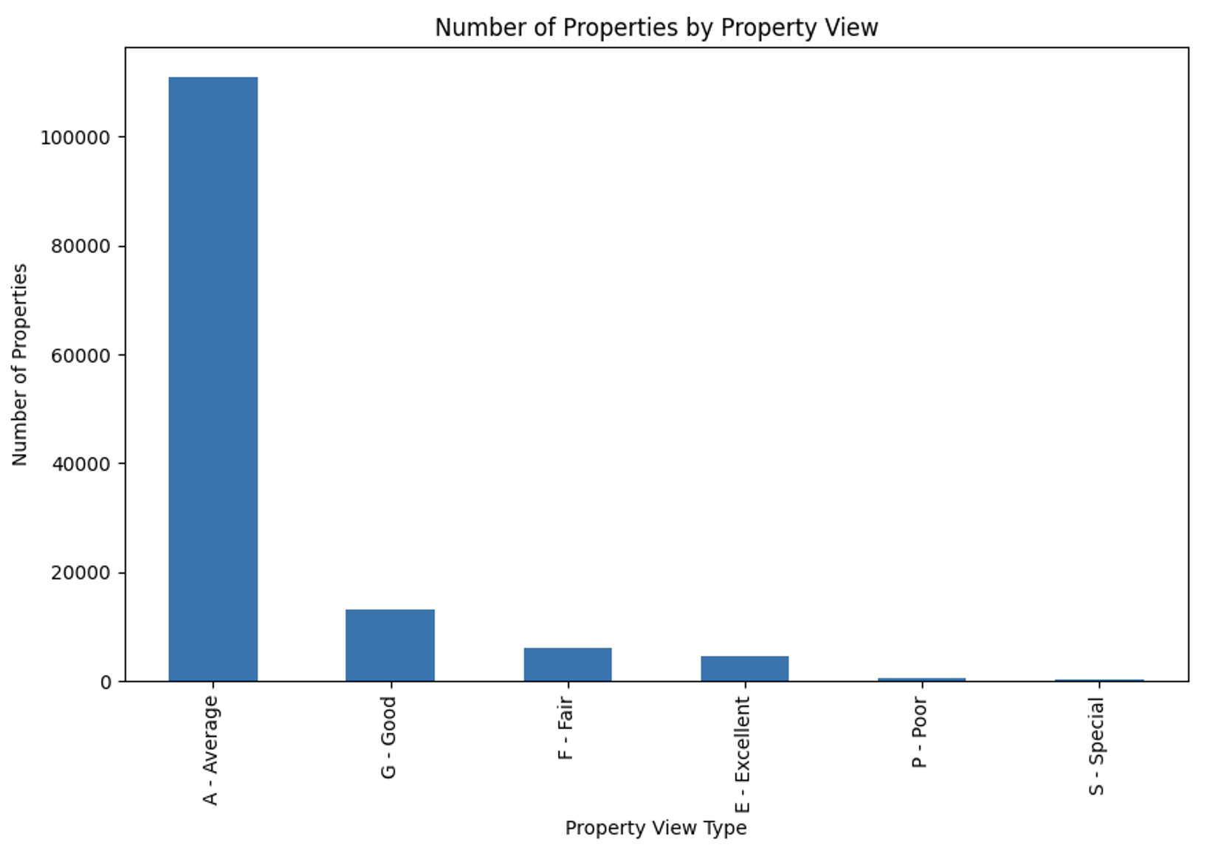
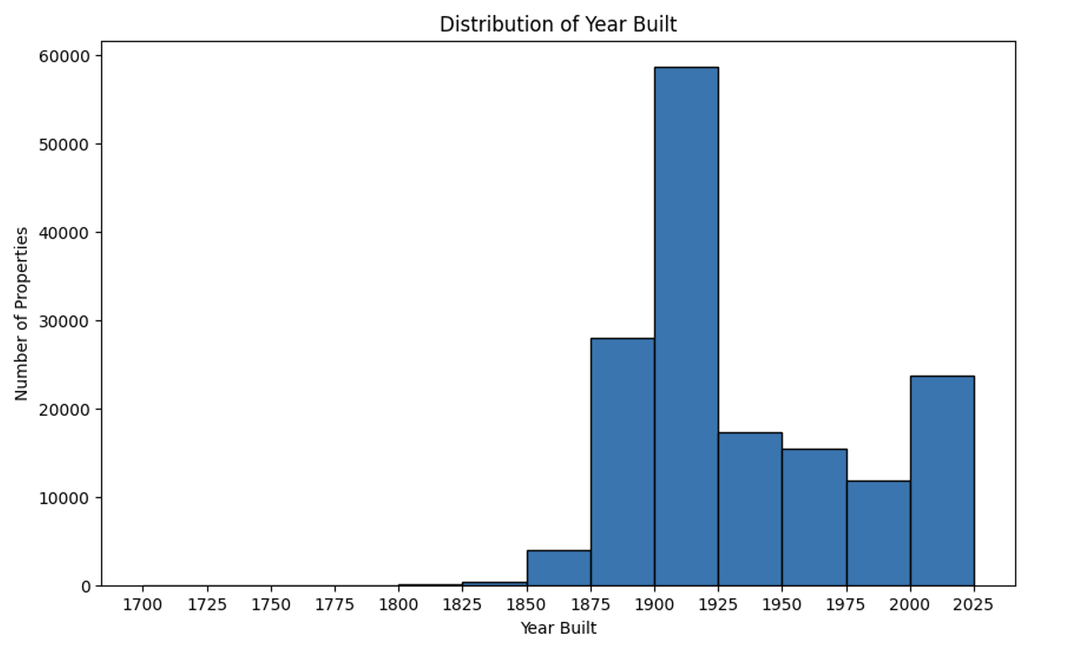
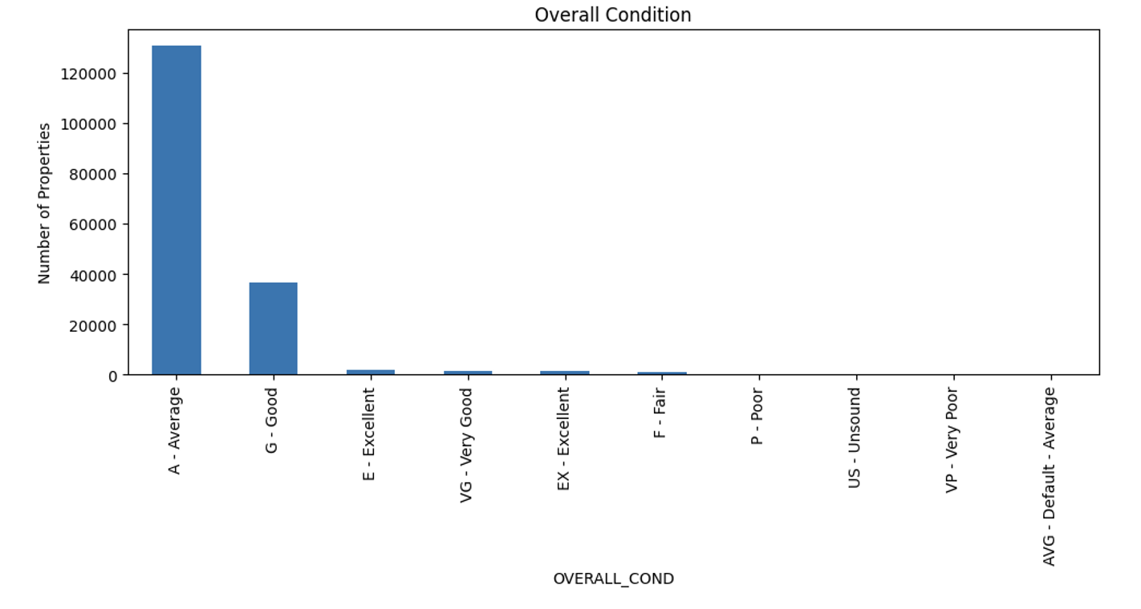
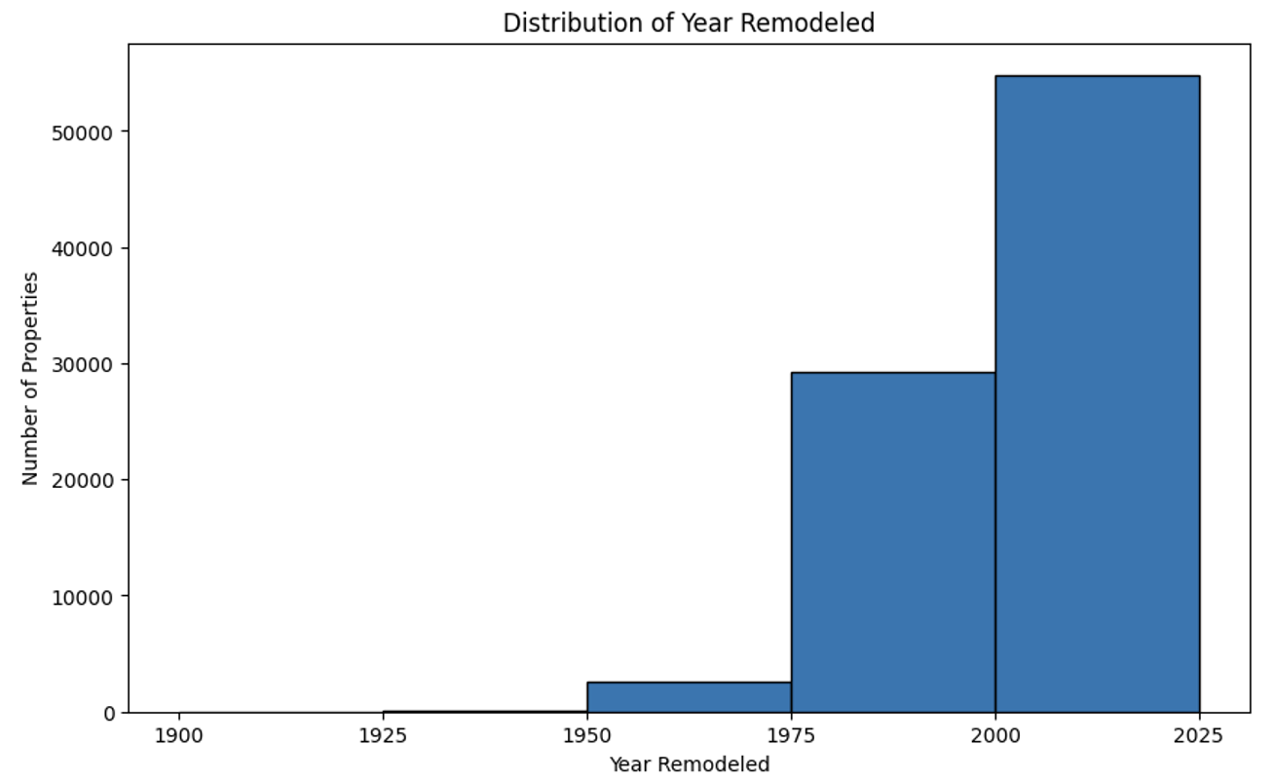
Insight 2: Common Features
Property View
Overall Conditions
Construction Year
Remodeling Year

Slide 7
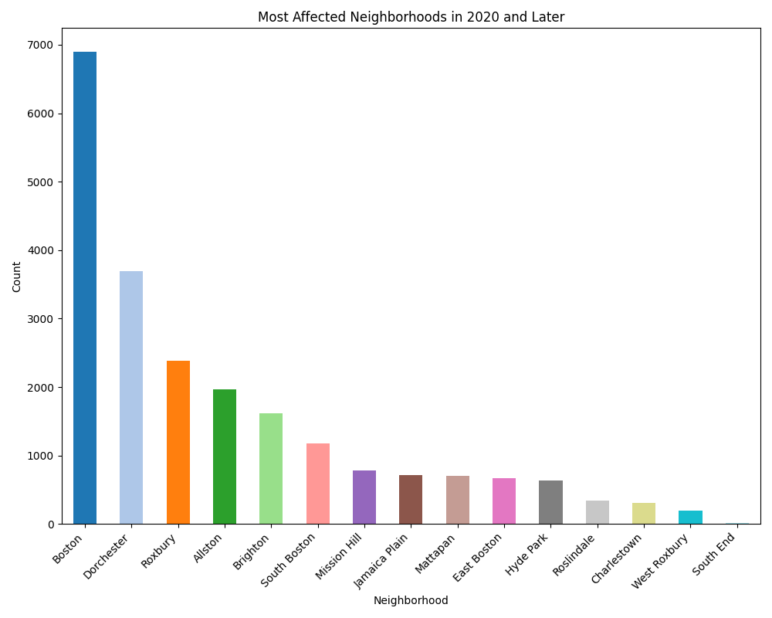
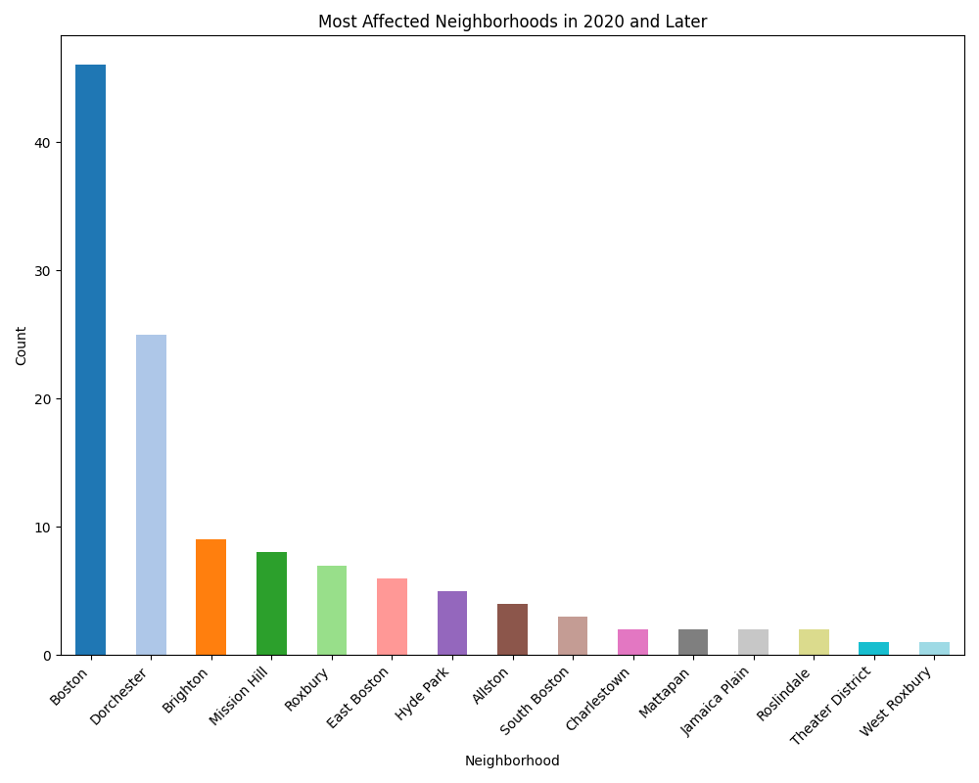
Insight 3: Most Affected Neighborhoods
Findings: The neighborhoods of Dorchester, Roxbury, and South Boston exhibit the highest number of building violations, indicating a concentrated need for municipal attention and resources.
Implications: These findings can guide urban planning and resource allocation, suggesting that interventions in these neighborhoods could significantly impact overall city compliance and community safety.

Slide 8
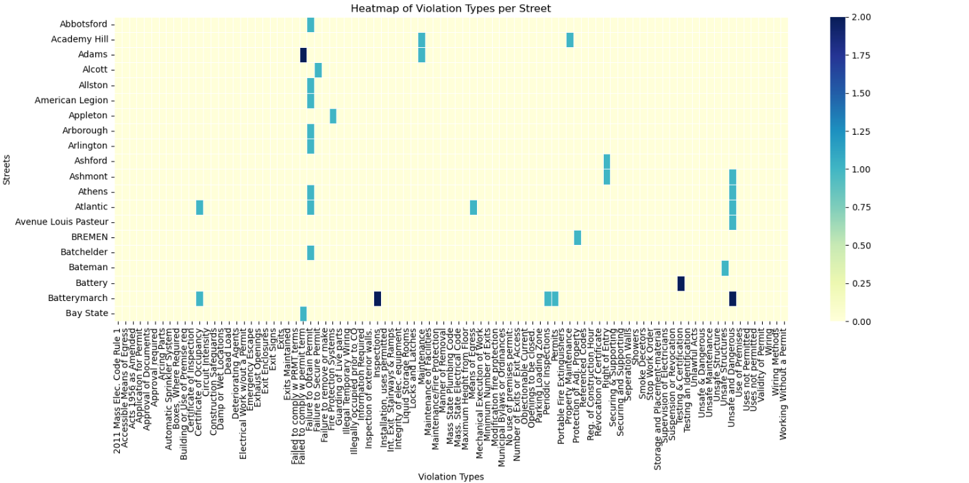
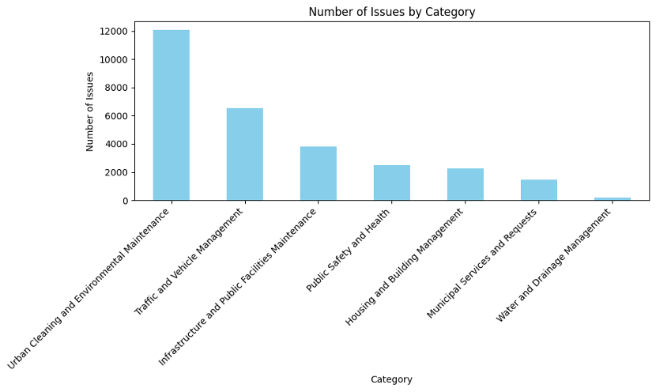
Insight 4: Main Complaints
Findings: The most common complaints are related to urban cleaning and environmental maintenance, traffic management, and safety violations such as faulty fire escapes and inadequate exit routes.
Implications: Understanding the types of complaints helps in prioritizing which building codes need more stringent enforcement and where public awareness campaigns could be most effective. It also assists in tailoring preventative maintenance programs to reduce these violations.

Slide 9

Further Explorations
Objective:
To explore the complex relationship between various demographic and environmental factors and their impact on building violations across Boston’s neighborhoods.
Rationale:
Understanding these dynamics helps in pinpointing targeted interventions for reducing violations and enhancing urban compliance and safety.

Slide 10
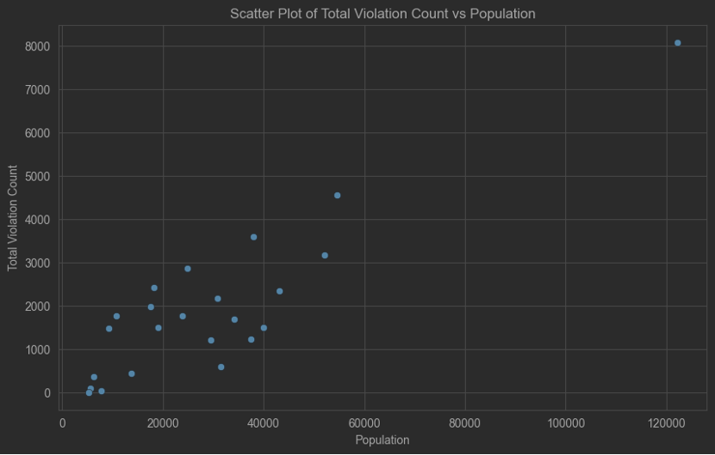
Insight 5: Population Size vs. Violations
Since the most accurate population data is only available up to 2020, we analyzed the relationship between violations recorded in 2020 and the population data of that year.
Intuitively, one would expect neighborhoods with larger populations to have more violations. Hence, we first explored the relationship between population size and the number of violations per neighborhood.

Slide 11
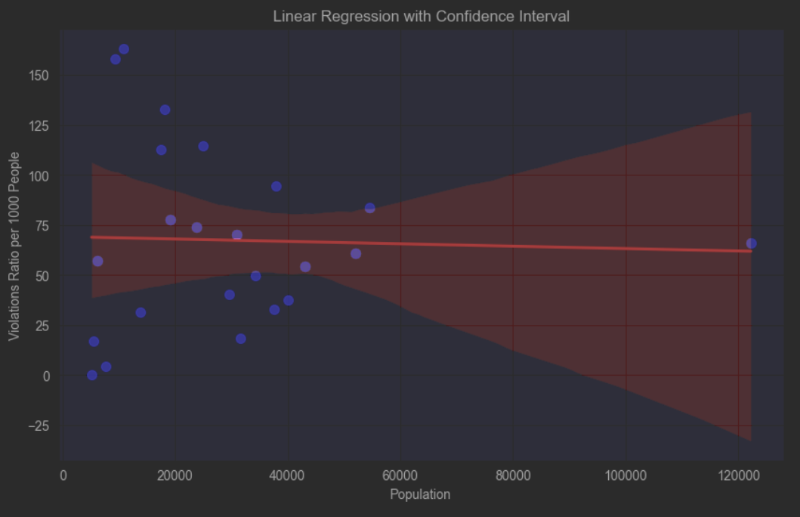
Population Size vs. Violations Cont.
The initial scatter plot confirmed a general positive correlation between population size and the number of violations.
However, using linear regression, and revising the y-axis to Violation Frequency, we found that this relationship is not significant, with no obvious trend and many data points falling outside the 95% confidence interval.
Thus, population size is not a definitive factor in predicting violations.

Slide 12
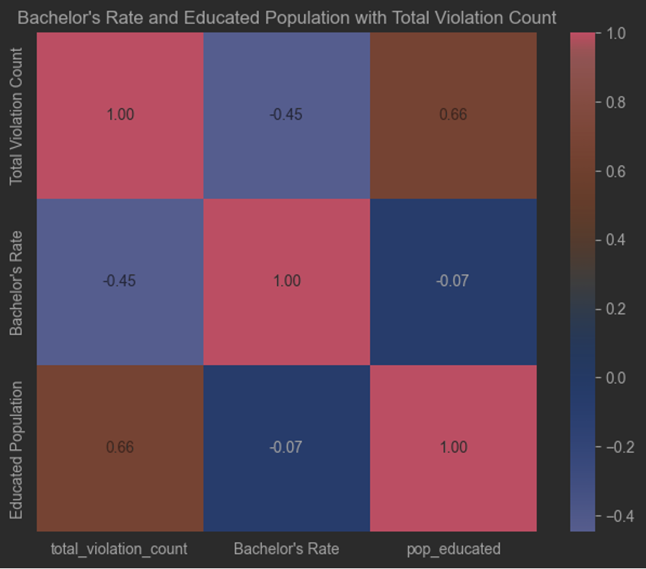
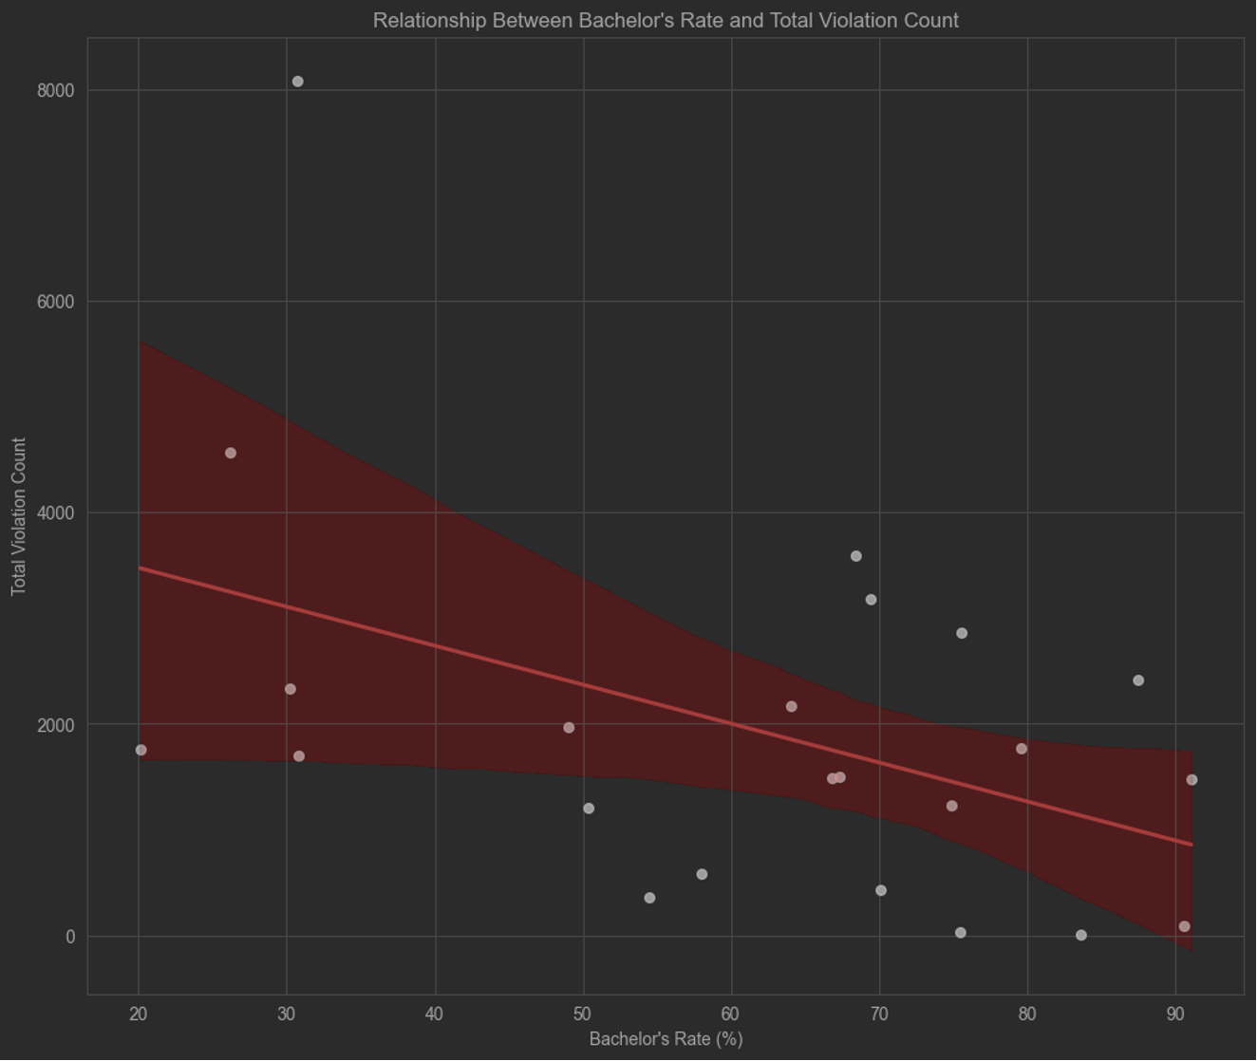
Insight 6: Education Level vs. Violation
Since using population size to predict violations is insufficient, we then delved deeper into the relationship between the proportion of residents with at least a bachelor's degree ("well-educated" population) and violations, using heatmaps and linear regression results.
From the graph, there is a negative correlation of -0.45 between the proportion of well-educated residents and violations.
Next, employing linear regression, over 50% of the data points fall within the 95% confidence interval, indicating a certain negative correlation between education level and violations.

Slide 13
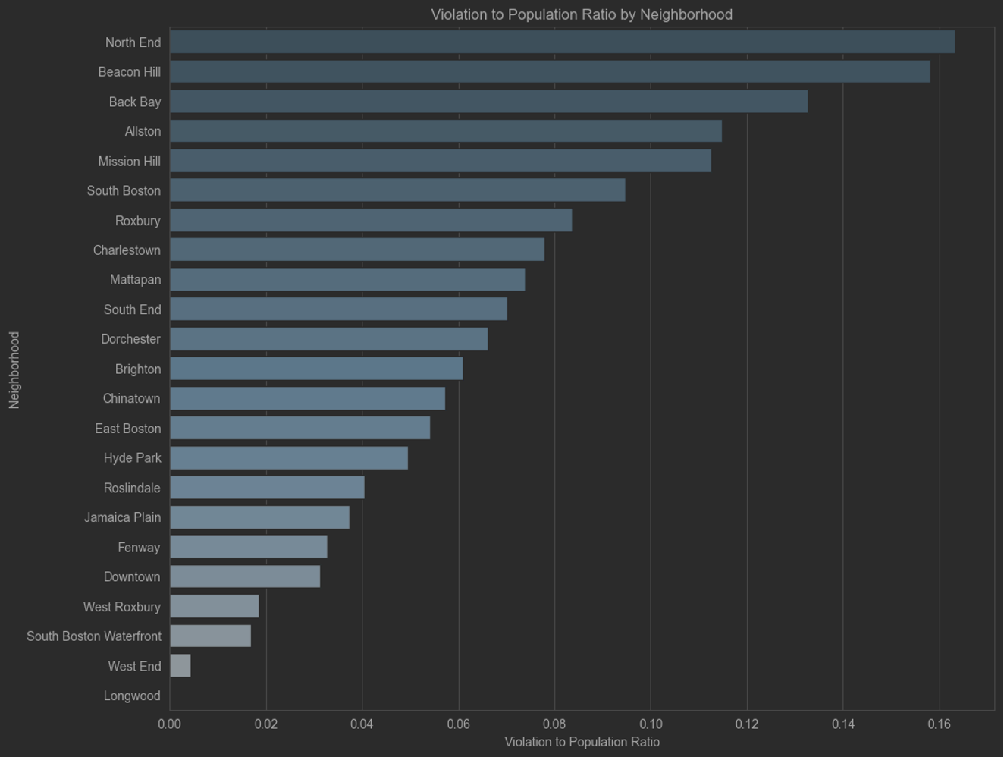
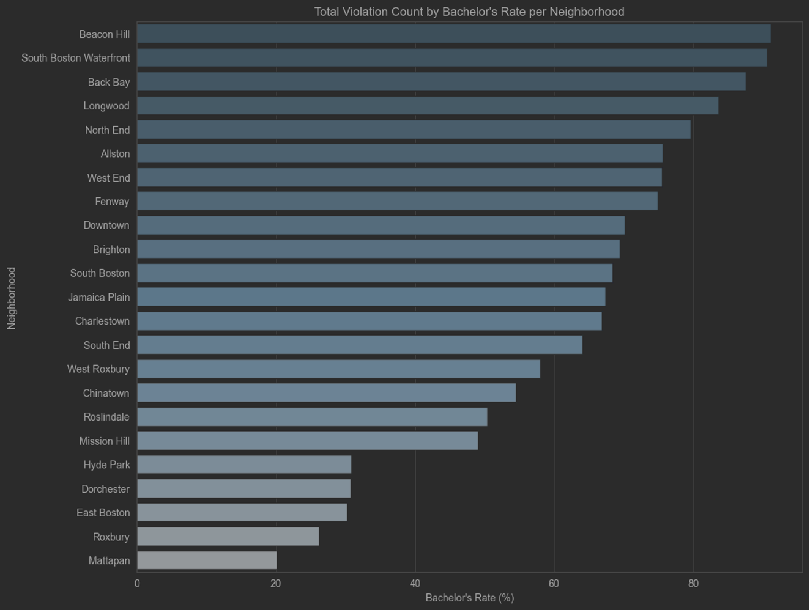
Education Level vs. Violation Cont.
The subsequent graphs illustrate the bachelor's degree rate by neighborhood, showing Beacon Hill with the highest rate exceeding 85%, while Mattapan has the lowest, around 20%. Another graph displays the number of violations per capita by neighborhood.
Notably, despite Beacon Hill having the highest education rate, it also has the second highest number of violations per capita, suggesting that merely increasing a neighborhood's educational level might not significantly reduce violations.
Conversely, Dorchester, with the highest population and number of violations, ranks below fourth from the bottom in terms of education level.
These indicate that violations are also closely related to many other factors.

Slide 14
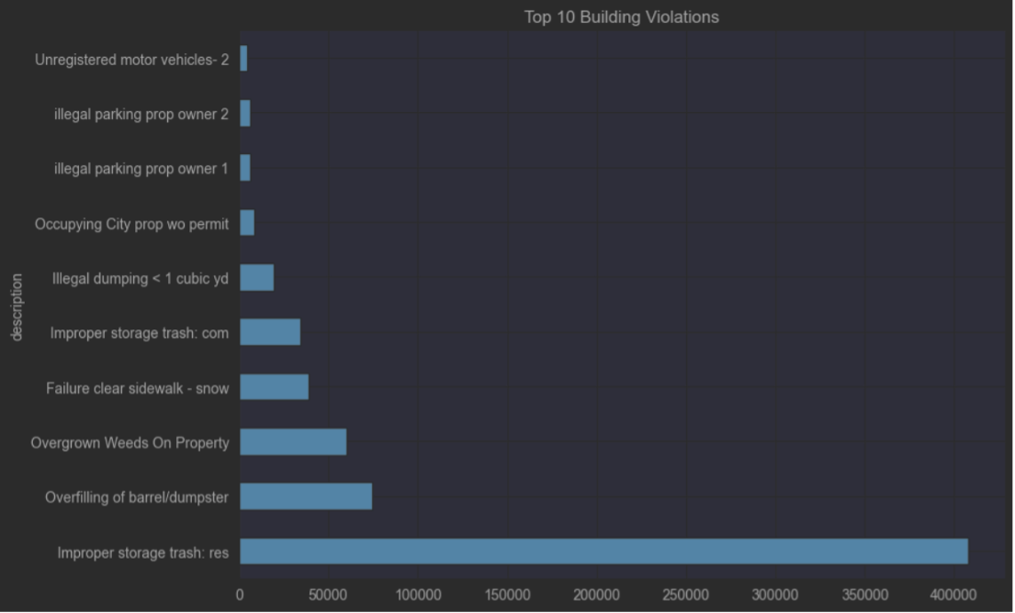
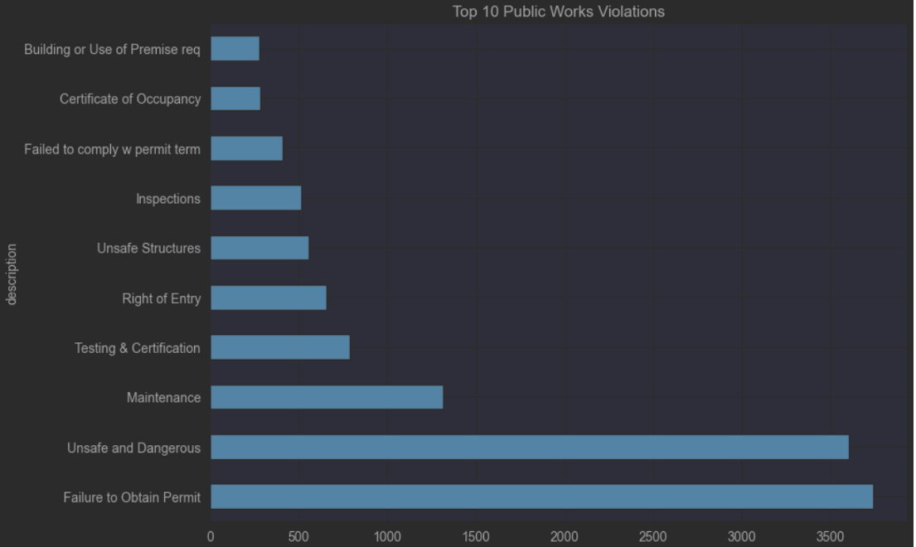
Insight 7: Time-based Analysis of Violations
Since the types of violations in the two datasets are not exactly the same, with each emphasizes different aspects, our subsequent analyses were conducted separately for each dataset. We selected the top 10 most common types of violations from each dataset for analysis.
The BUILDING_AND_PROPERTY_VIOLATIONS dataset focuses on property owners' responsibilities, such as maintaining property cleanliness and compliance with city ordinances, as well as adhering to regulations concerning property use.
The PUBLIC_WORKS_VIOLATIONS dataset is more aligned with public safety and structural integrity, as well as ensuring that building owners follow construction standards and government-imposed procedures.

Slide 15
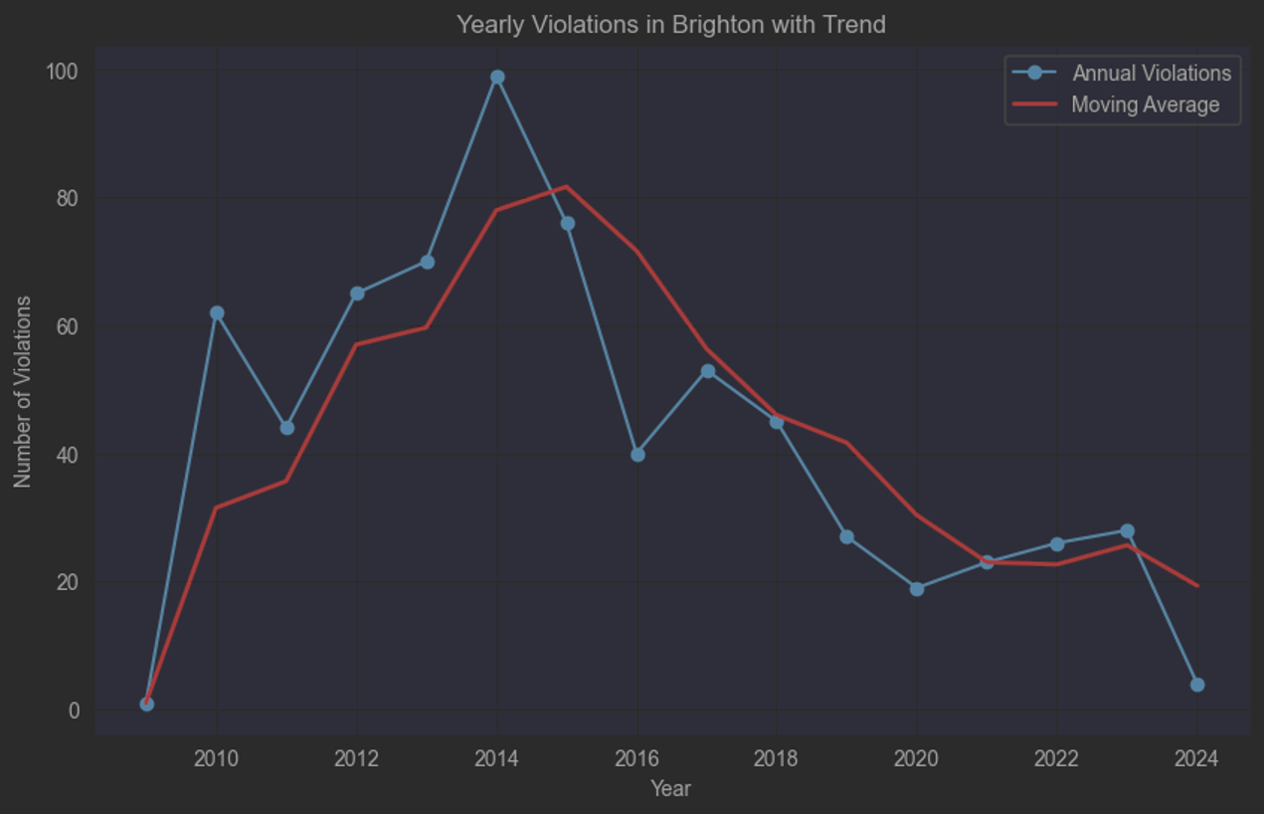
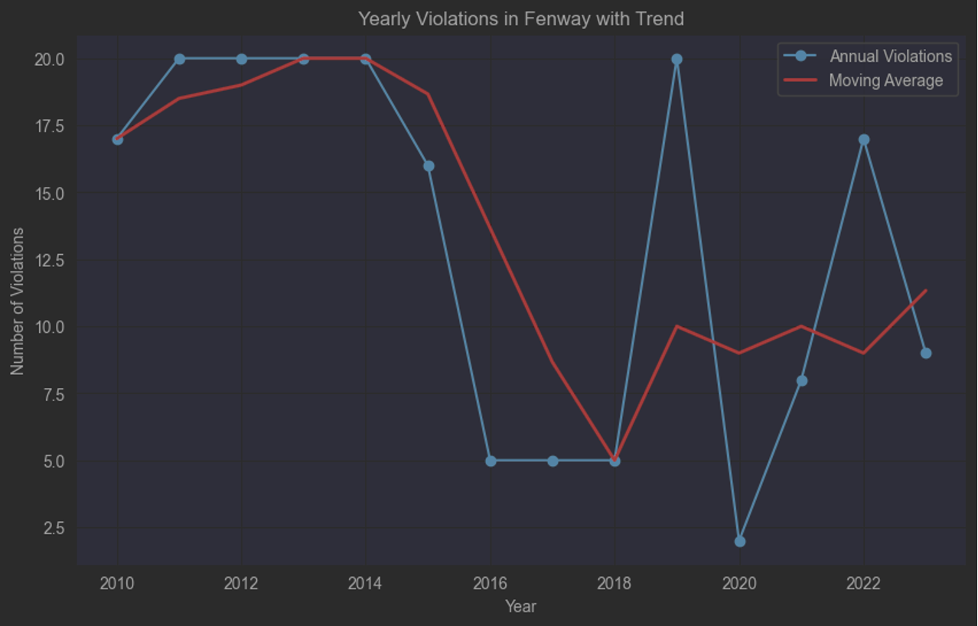
Temporal Analysis Cont.
For the PUBLIC_WORKS_VIOLATIONS dataset, we recorded the number of violations per neighborhood annually and observed trends from around 2010 to 2024.
Each neighborhood showed a trend of initially rising and then declining, resembling a hill, but the peak years varied.
For example, Brighton peaked in 2014, after which the situation improved.
However, recently in some places, violations have shown an upward trend, like Fenway. This could suggest an increased public safety awareness.

Slide 16
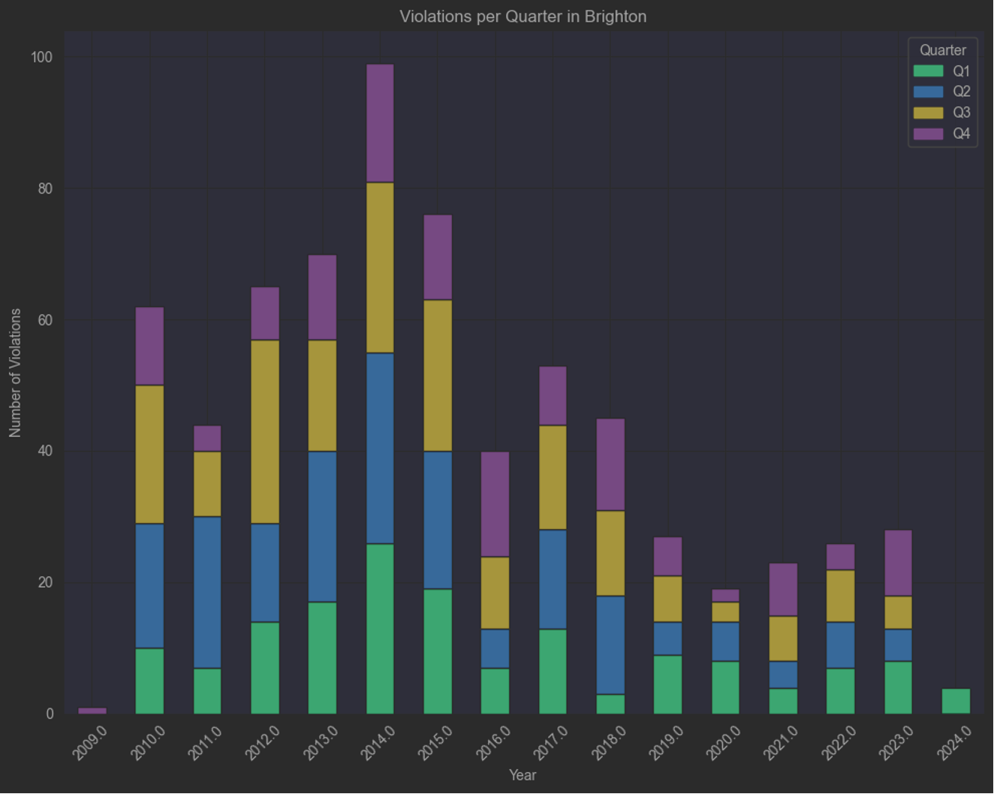
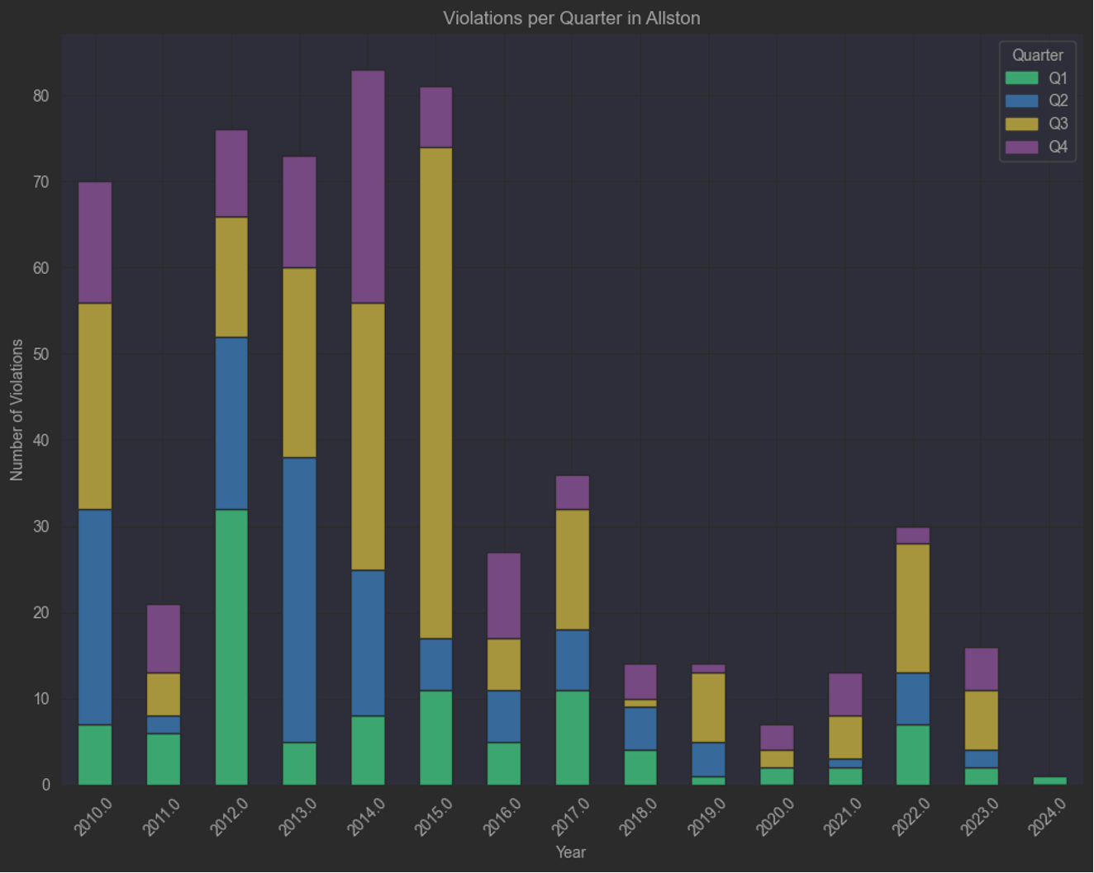
Quarters of the Year vs. Violations
Next, we also explored the relationship between seasons and violations, representing each neighborhood's quarterly data annually with different colors on bar graphs.
Each neighborhood displays unique characteristics, and there is no consistent trend applicable to all neighborhoods.
For instance, shown by the graphs, violations in Allston are mainly centered around the third quarter, whereas in Brighton, it’s basically the same across the second, third, and forth quarter.

Slide 17
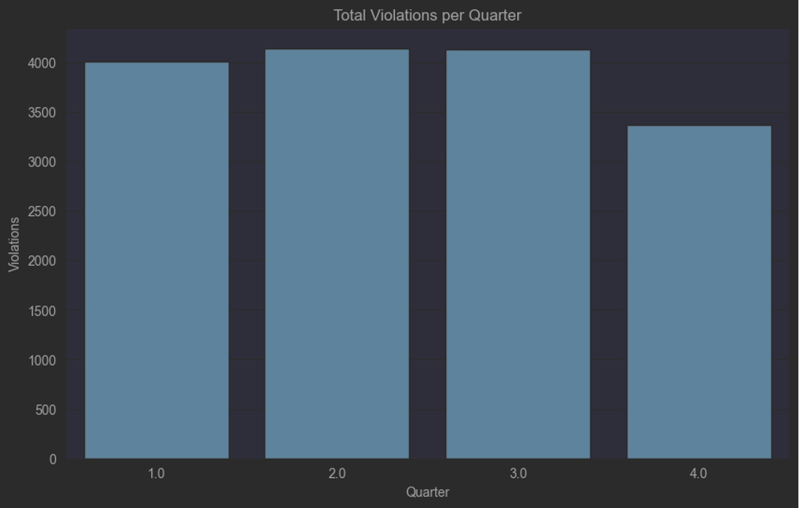
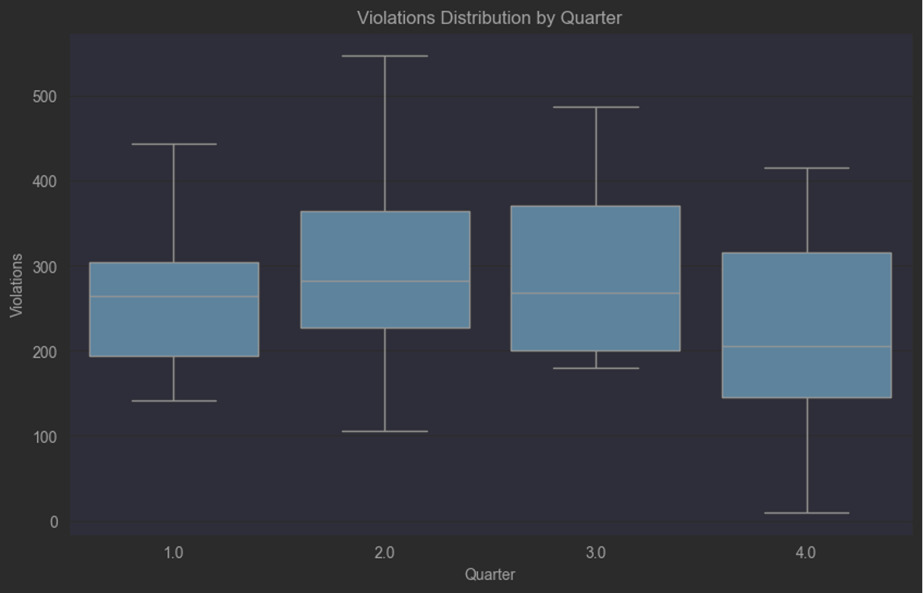
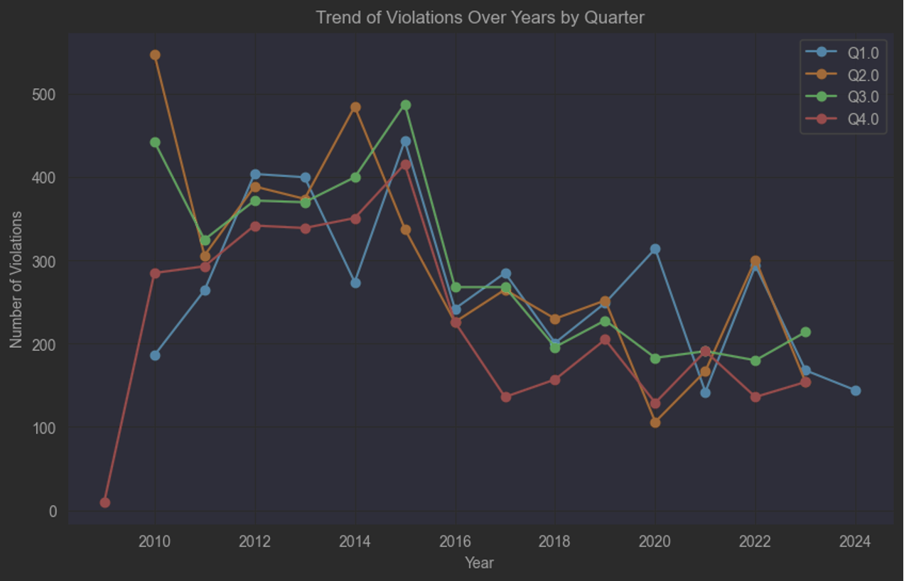
Analysis by Quarter Cont.
Lastly, we explored the overall case by quarter. The box plot beside shows that the second and third quarters have slightly higher median violation numbers and quartile ranges than the first and fourth quarters, indicating that these quarters see more violations.
From the trend lines of each quarter annually, overall violations are declining, but each quarter has had years when it led in numbers, showing that no certain quarter is consistently prone to more violations.

Slide 18
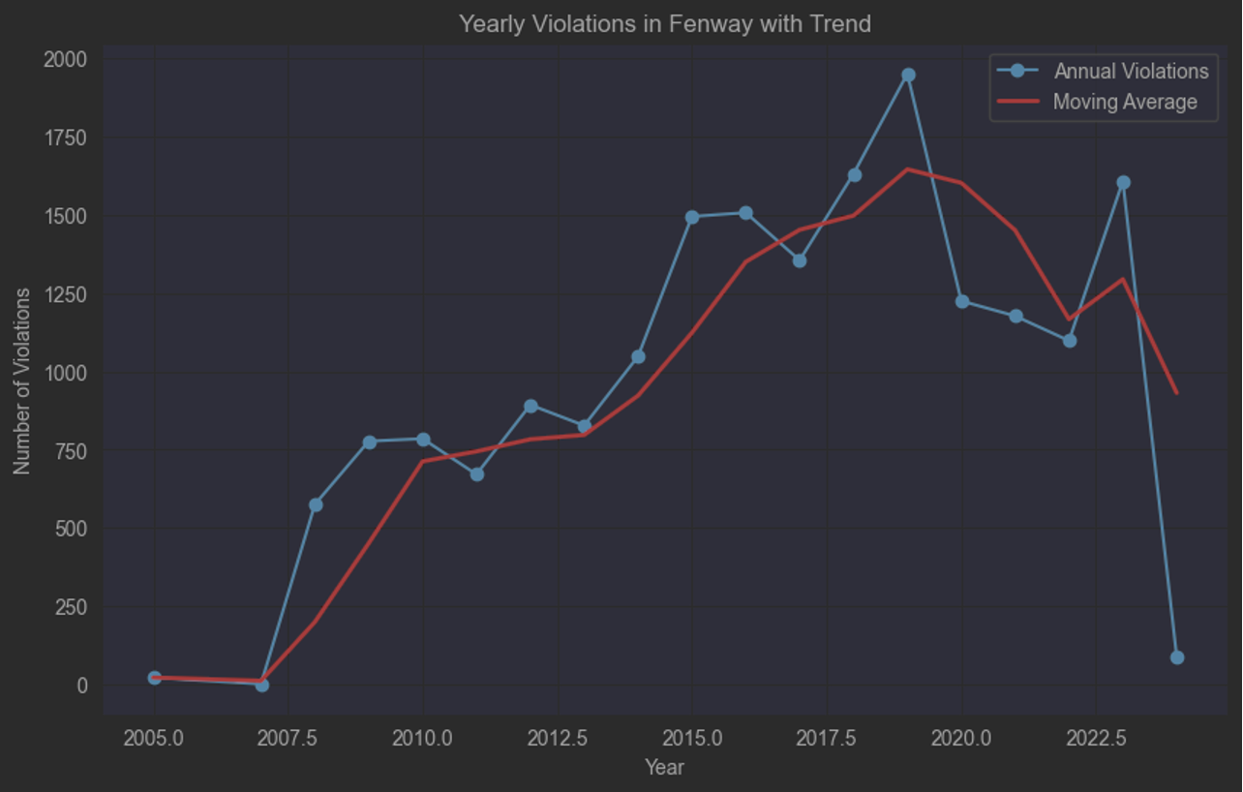
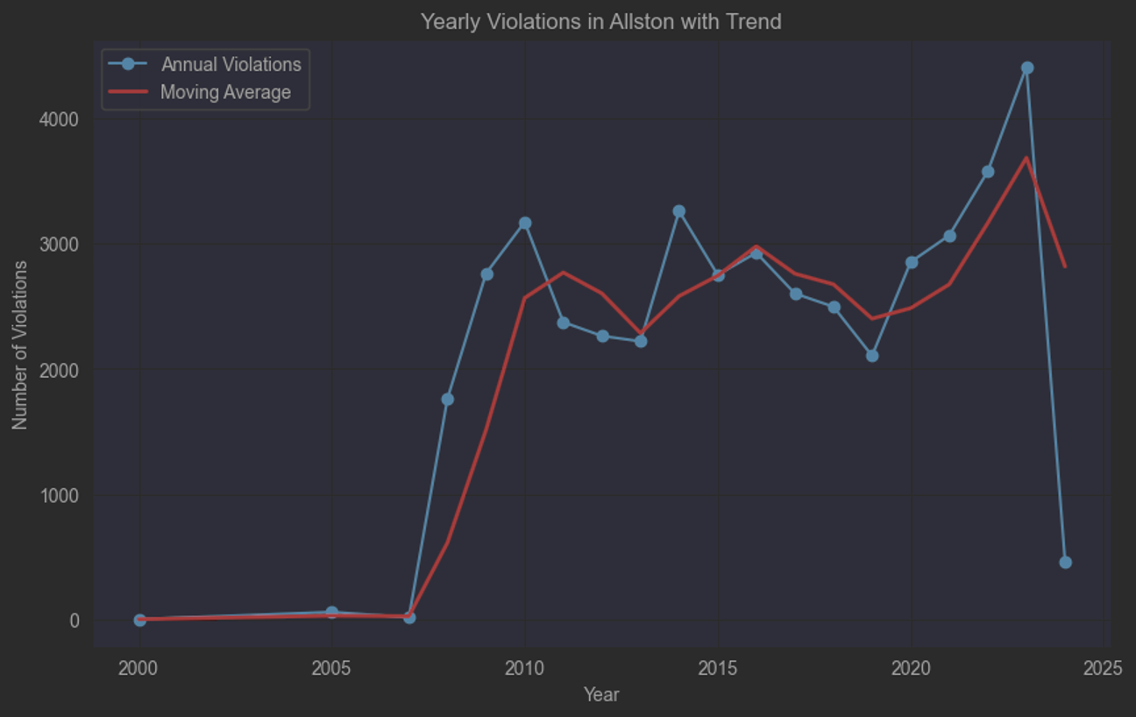
Temporal Analysis Cont.
Then, for the BUILDING_AND_PROPERTY_VIOLATIONS dataset, we did similar analysis as before.
While in the last dataset, most neighborhoods generally show a declining trend of violations in recent years, this dataset indicates an increasing trend in the number of violations across most neighborhoods from 2015 to 2020.
Specifically, Allston and Fenway have seen a steady increase in violations over recent years.
This trend could likely be associated with changes in regulatory enforcement or other external factors affecting these areas.

Slide 19
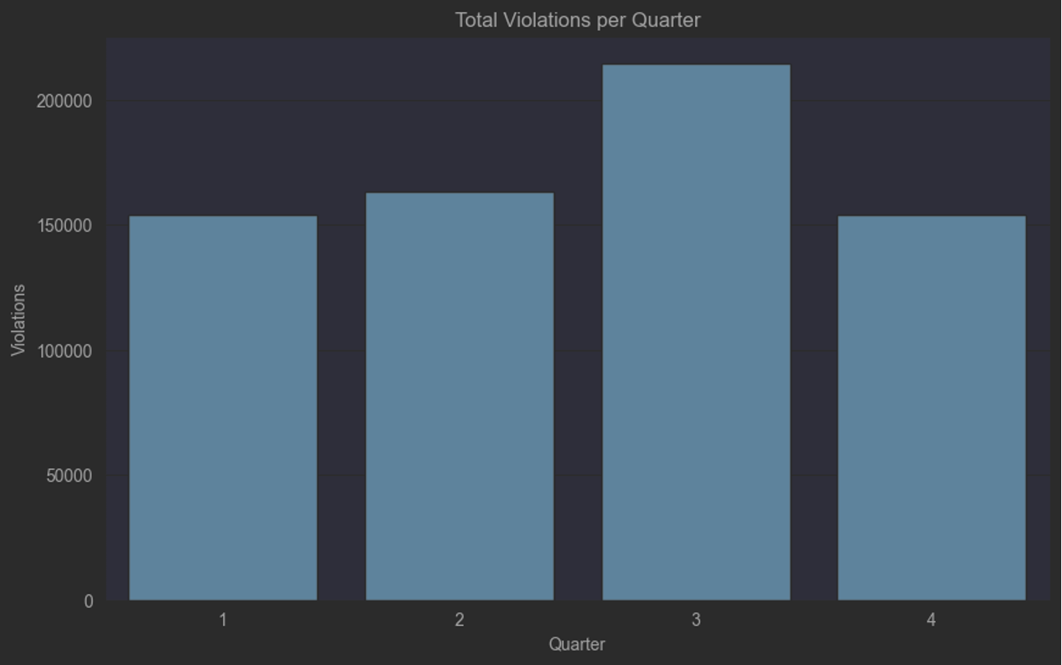
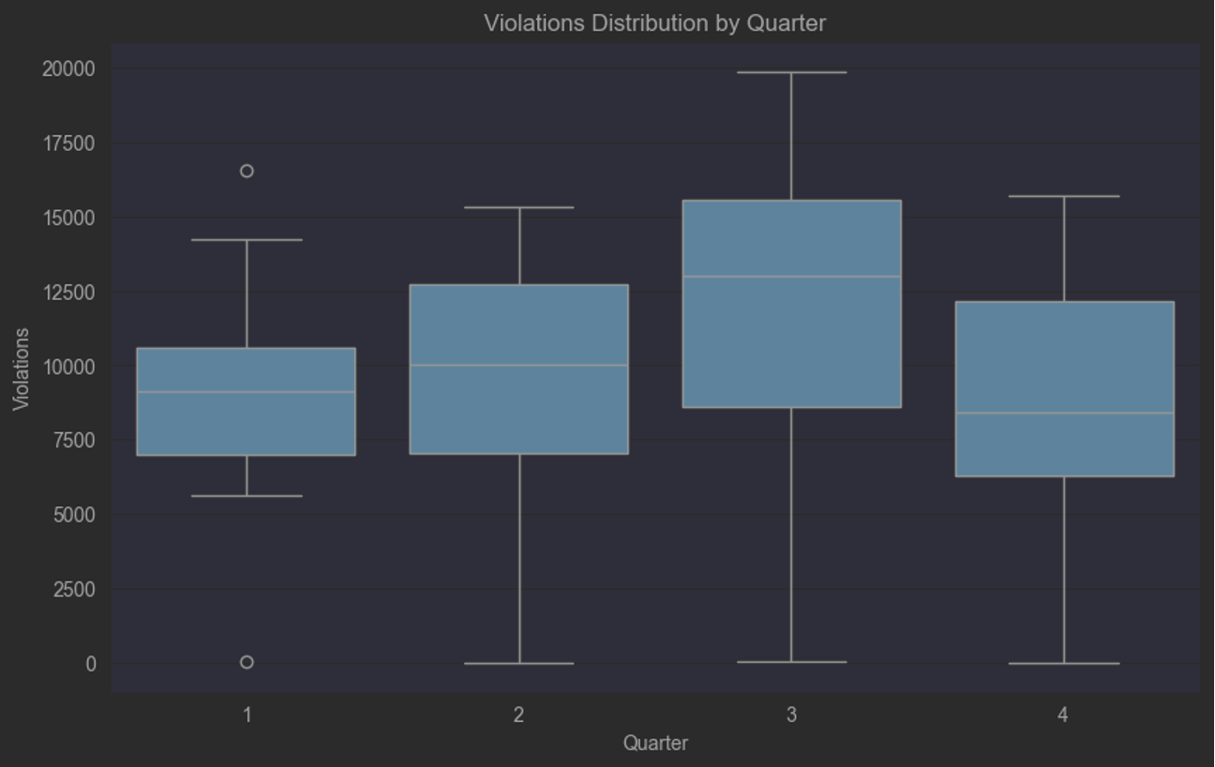
Quarters of the Year vs. Violations
Next, we also explored the relationship between quarters and violations. The box plot and bar graph below show that the number of violations in the third quarter exceeds the other three quarters.
This suggests that issues such as property maintenance, cleanliness, and compliance with city ordinances are more likely to occur in the third quarter.
We think that this may be closely related to the moving season associated with the start of the academic year, especially since Boston is a city with a high concentration of universities.

Slide 20
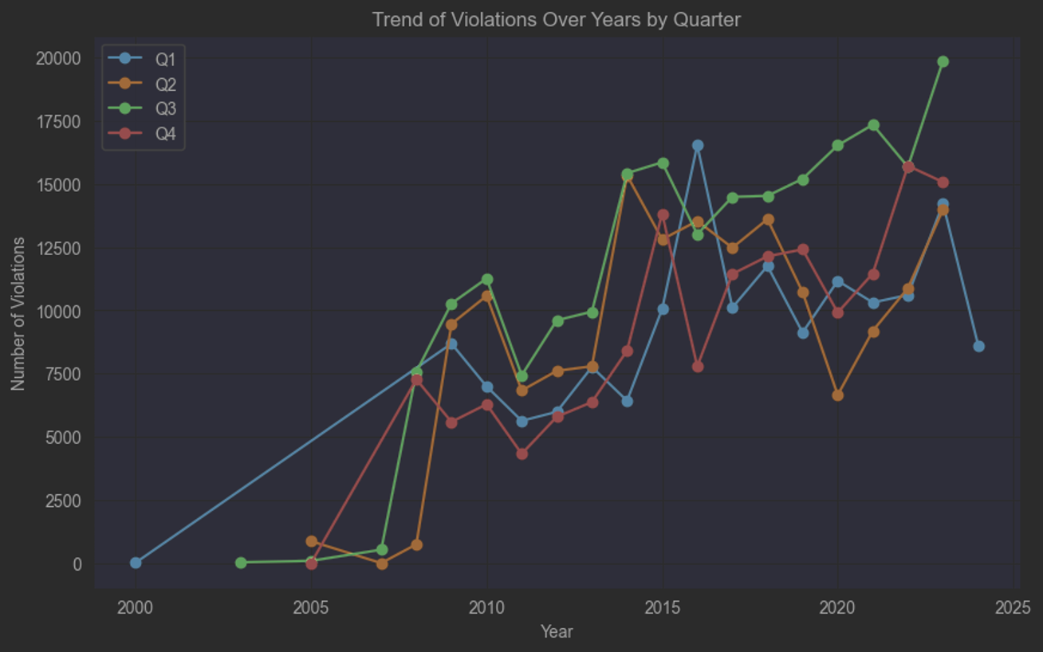
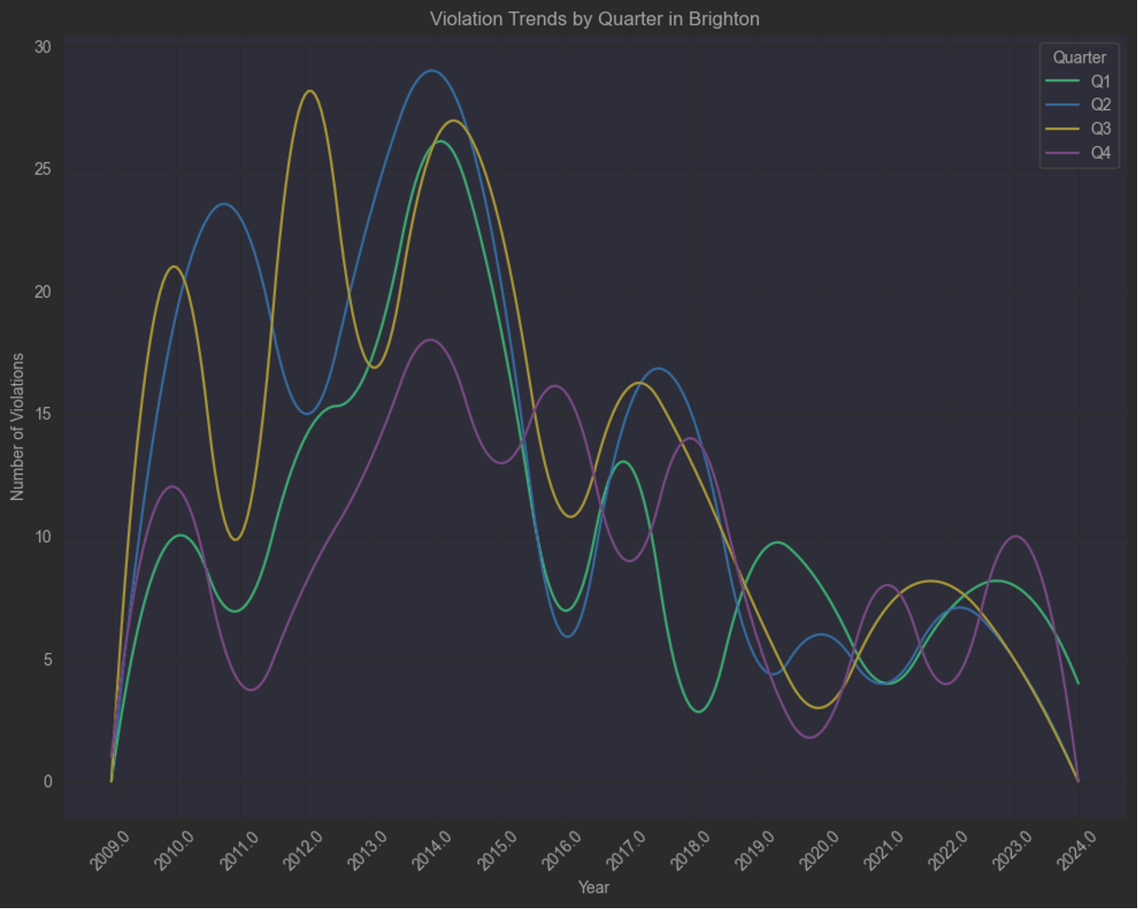
Analysis By Quarter Cont.
Finally, from the line graph on the left, it is evident that the third quarter, represented by the green line, is gradually becoming the quarter with the most violations. This indicates that the third quarter is becoming the peak season for violations within the year.
We have also attempted to analyze the trends for each neighborhood by quarter, but as shown in the graph on the right, the situation in each neighborhood is chaotic and lacks clear characteristics.

Slide 21

Insight 8: Property Numbers vs. Violations
Broadening our analysis, we next categorized all items in the PROPERTY_ASSESSMENT dataset into corresponding neighborhoods, thus obtaining the number of properties per neighborhood.
We then extracted the number of properties that had experienced violations based on the two violation datasets and analyzed their ratios.

Slide 22
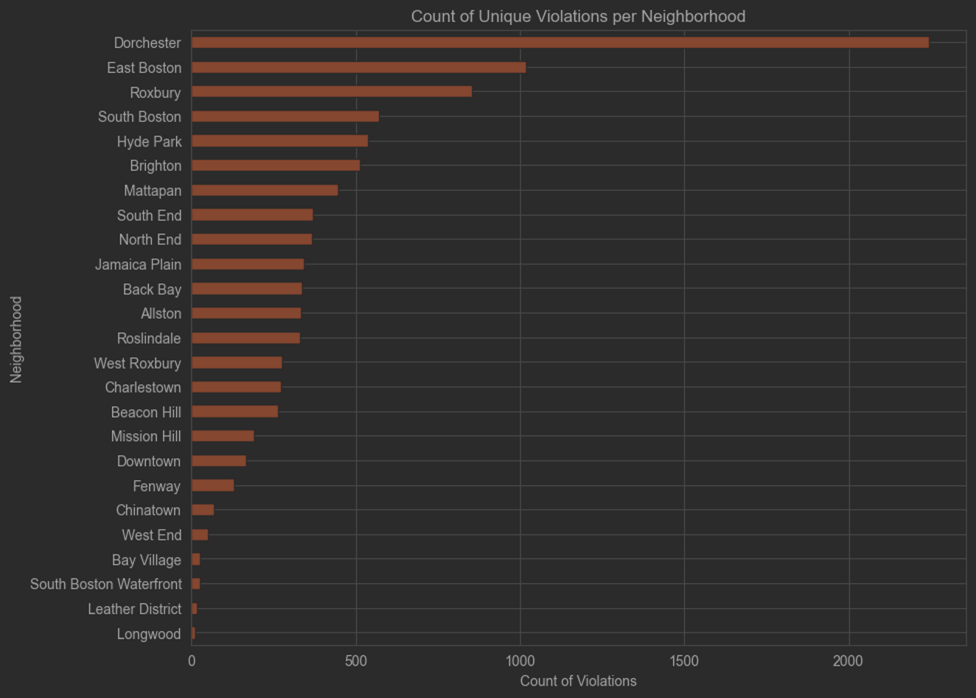
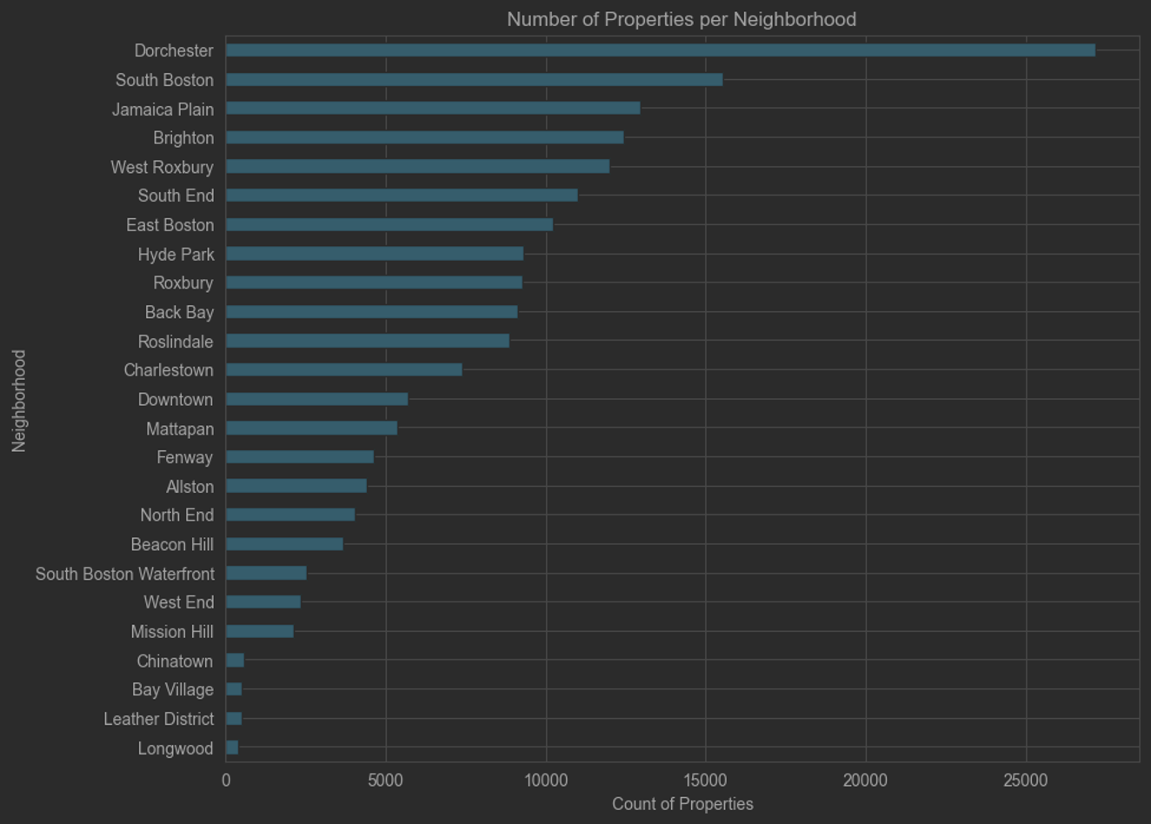
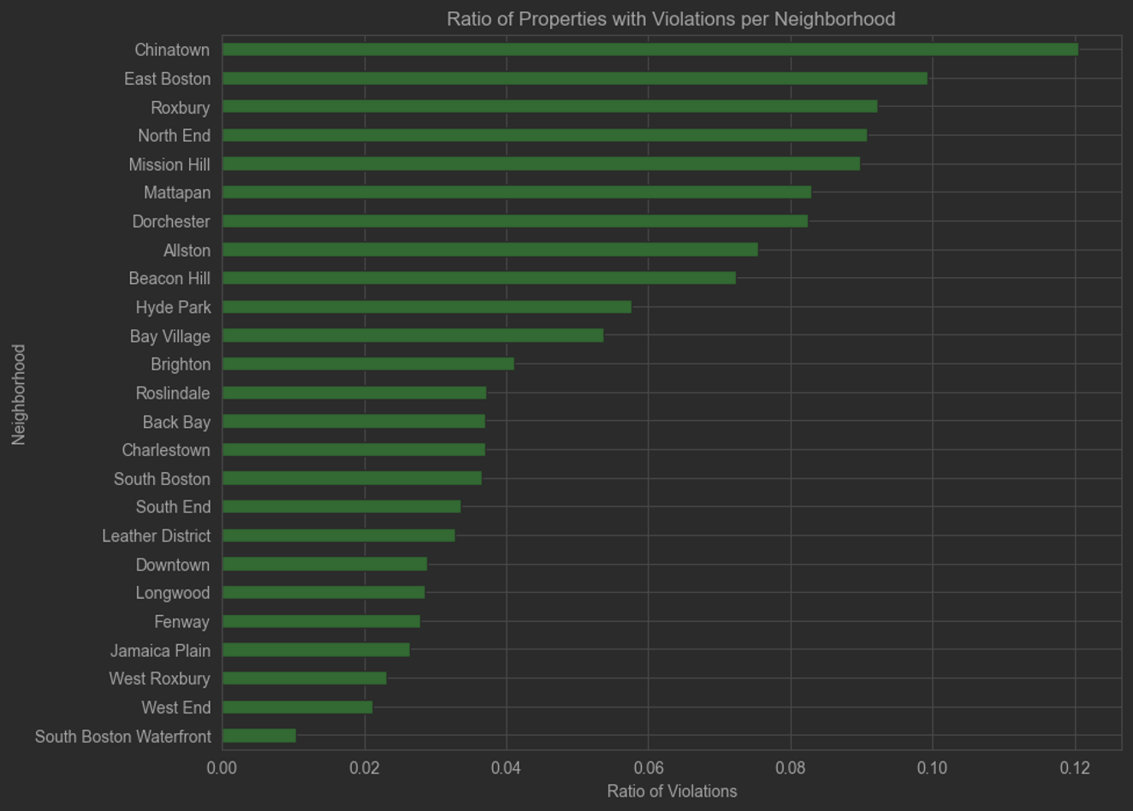
Property Numbers vs. Violations Cont.
For the PUBLIC_WORKS_VIOLATIONS dataset:
As seen in the graph, although Dorchester has the most properties and properties with violations, Chinatown has the highest violation rate, with over 12% of properties experiencing violations. Dorchester's rate is between 8% to 10%, ranking it seventh.

Slide 23
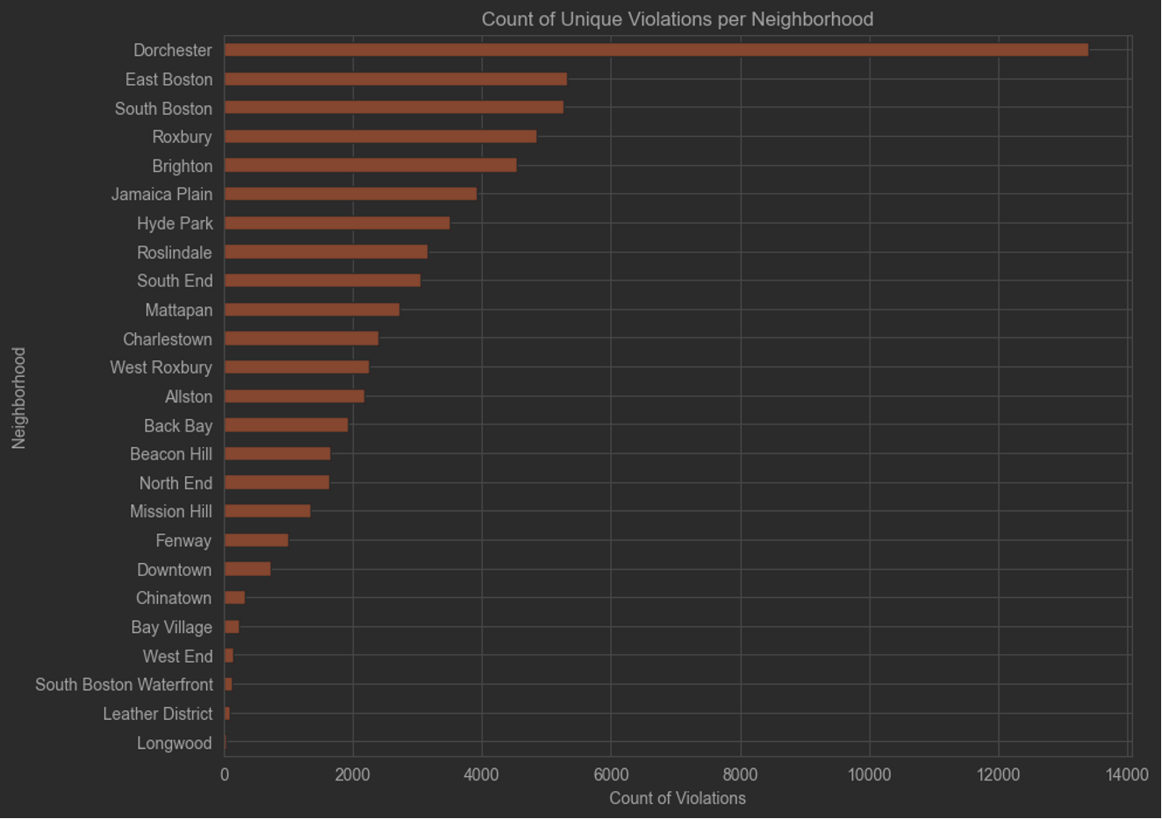
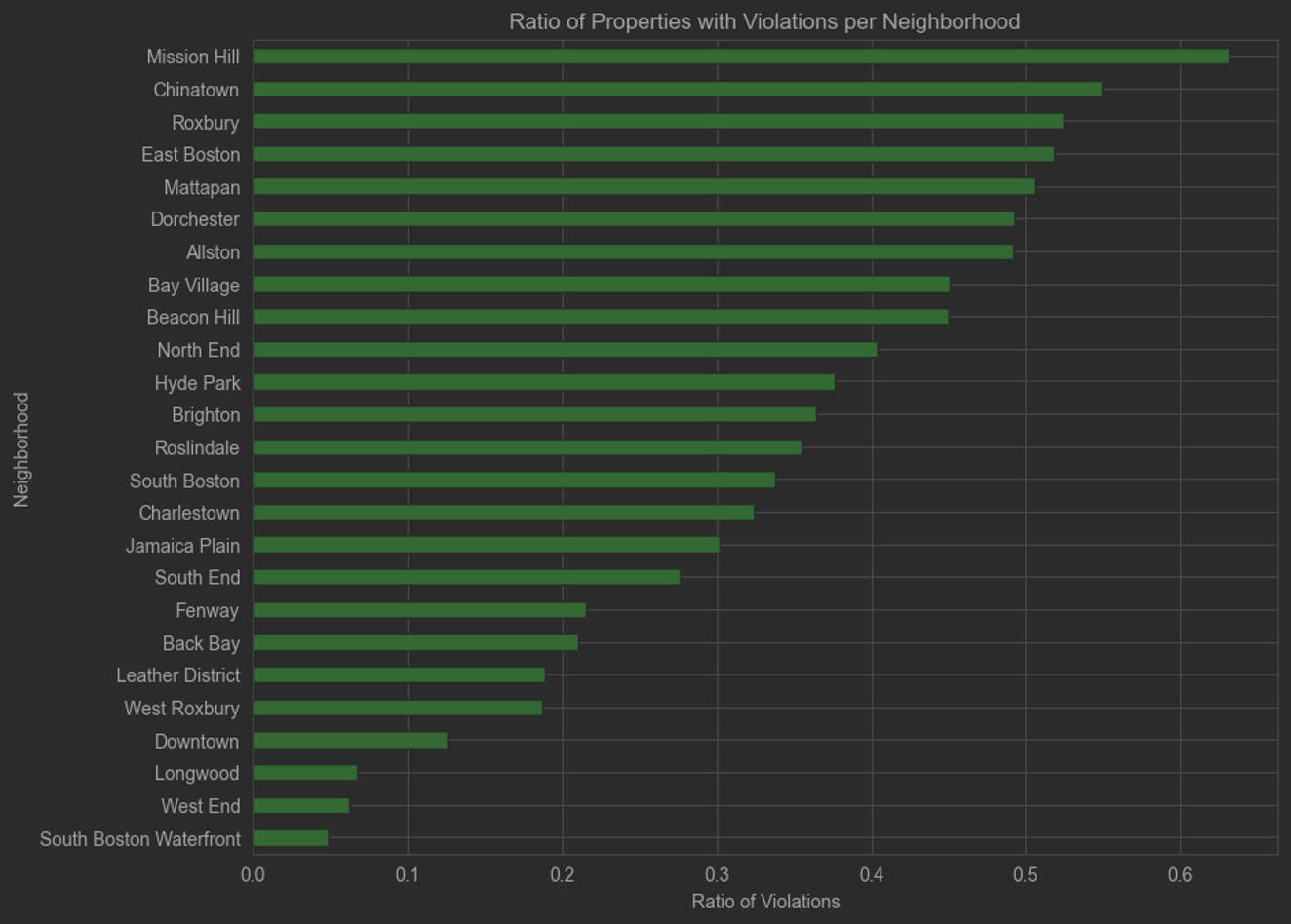
Property Numbers vs. Violations Cont.
As for the BUILDING_AND_PROPERTY_VIOLATIONS dataset:
Employing the same analysis process as before, the resulting graphs, sequentially, show the number of properties with violations and the ratio of properties with violations to total properties in each neighborhood.
Dorchester leads in the number of properties with violations, but neighborhoods like Mission Hill, Chinatown, and Roxbury have the highest rates, with Mission Hill exceeding 60%. This indicates a higher likelihood of building violations in these areas.

Slide 24
Key Takeaways
Overall, while the two datasets vary in scale and focus, the neighborhoods that rank high in violation rates are generally consistent across both datasets
The higher rates of violations in neighborhoods with fewer properties like Mission Hill suggest a higher risk of violations per property, which could be indicative of deeper underlying issues such as socio-economic factors or zoning regulations.
This property analysis also shows that violation rates do not necessarily correlate directly with the number of properties.

Slide 25
Economic Influences on Violations
Extending our analysis further, the following segment of our study focuses on deciphering the economic dimensions that may influence the incidence of building violations in Boston. We investigate the interconnections between rental costs, resident income levels, and their collective impact on housing violations.
Our primary hypothesis posits that higher rent indices correlate with better housing quality, hence lower violation frequencies. Conversely, we surmise that lower household incomes could be associated with increased violation rates due to potential constraints on housing maintenance and quality of living conditions.
We sourced our rental data from Zillow’s Observed Rent Index (ZORI), which provides a comprehensive view of the typical market rent. For income statistics, we utilized data from incomebyzipcode.com. These economic indicators were cross-referenced with housing violation frequencies derived from Boston's 311 service requests dataset.

Slide 26
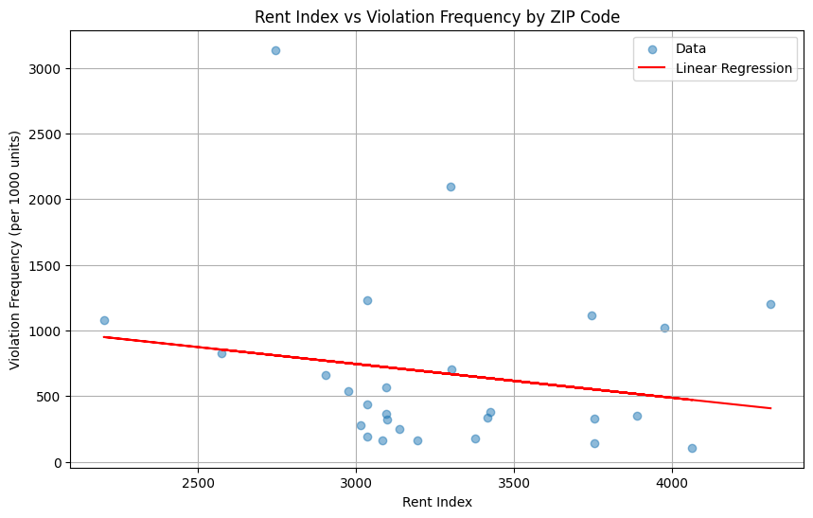
Insight 9: Rent Index vs. Violation Frequency
Rental Index:
Zillow’s Observed Rent Index (ZORI) serves as our proxy for housing quality. It is a weighted average designed to reflect the rents of all properties in the market, smoothing out the extreme values.
Violation Frequency:
Violation frequency was calculated per 1,000 residential units to ensure comparability across zip codes with varying numbers of residential properties.
Linear Regression Findings:
Our linear regression model, displayed on the graph, reveals a downward trend line. This negative slope indicates that as ZORI increases, suggesting higher rents and potentially better housing quality, the frequency of violations per 1,000 units tends to decrease.
Statistical Interpretation:
While the overall trend supports our hypothesis, the presence of outliers signifies the influence of additional factors. Some high-rent districts still experience a notable number of violations, indicating that high rent alone isn't a blanket deterrent to violations.

Slide 27
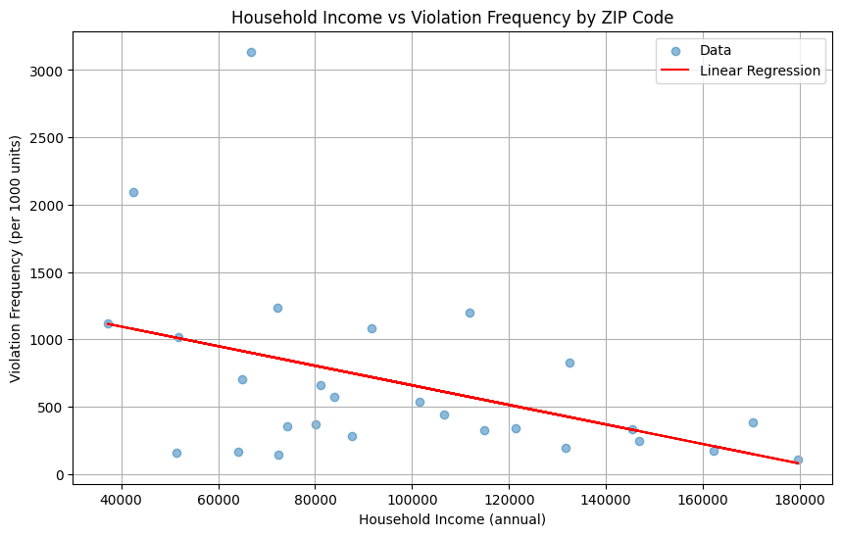
Insight 10: Household Income vs. Violation Frequency
Next, we used the median household income data from incomebyzipcode.com to construct a socio-economic profile for each ZIP code. We then juxtapose this data with violation frequencies to investigate potential economic disparities.
Regression Analysis Insights:
The linear regression model depicted in the accompanying graph demonstrates a clear negative correlation. As median household incomes rise, the frequency of housing violations per 1,000 units declines. The slope of our regression line is negative, and most data points fall close to this line, indicating a strong relationship between income levels and housing violation frequencies."
Contextual Analysis:
This inverse relationship may be indicative of higher-income households having more resources for property upkeep and adherence to housing regulations, thereby reducing the likelihood of incurring violations.
Nonetheless, the trend's outliers suggest that income is not the sole determinant of housing conditions.

Slide 28
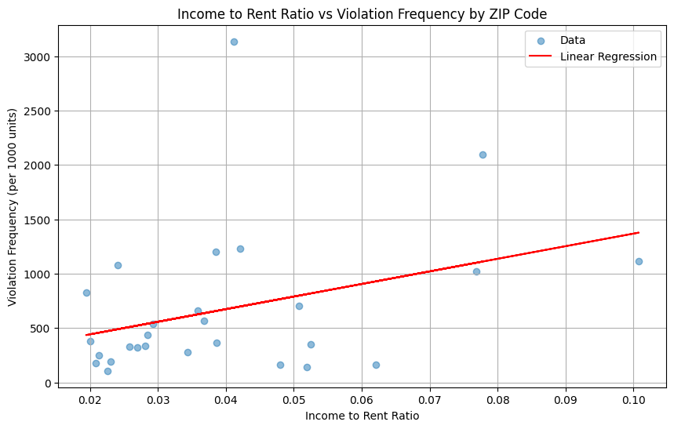
Insight 11: Income to Rent Ratio vs. Violations
Delving deeper, beyond absolute income levels, we examined the proportion of income that households allocate towards rent, hypothesizing that a lower income-to-rent ratio may correspond to a lesser likelihood of housing violations, reflecting better living conditions and maintenance capacity.
Our regression model indicates a positive slope, suggesting that as the proportion of income spent on rent decreases, the frequency of violations per 1,000 units also diminishes.
This relationship, while present, is not as pronounced as the income-violation correlation, signaling that affordability plays a role, but its influence is subtler.
A lower income-to-rent ratio may indicate more disposable income for home maintenance and investment in living conditions, which could contribute to compliance with building standards. However, the modest slope of the trend line and the variability among data points remind us that affordability is one piece of a larger puzzle.

Slide 29
Economic Influence Takeaways
Key Insights:
Areas with higher Rent Index values, reflecting higher rents, generally report fewer violations per 1,000 units, suggesting better housing quality and maintenance.
Higher household incomes are associated with lower rates of violations, indicating that economic prosperity could translate into improved housing conditions and compliance.
The Income to Rent Ratio, while less pronounced, still underscores the importance of affordability and disposable income in the context of housing quality.
Policy Implications:
The data informs us that interventions aimed at improving housing conditions and reducing violations should be socio-economically sensitive, targeting not just the physical infrastructures but also the economic realities of residents.
Policies could include targeted subsidies for housing maintenance in lower-income areas, incentives for landlords to improve property conditions, and community-based initiatives to raise awareness about housing standards.

Slide 30
Q & A

Slide 31
Thanks for watching!

